Slide 1

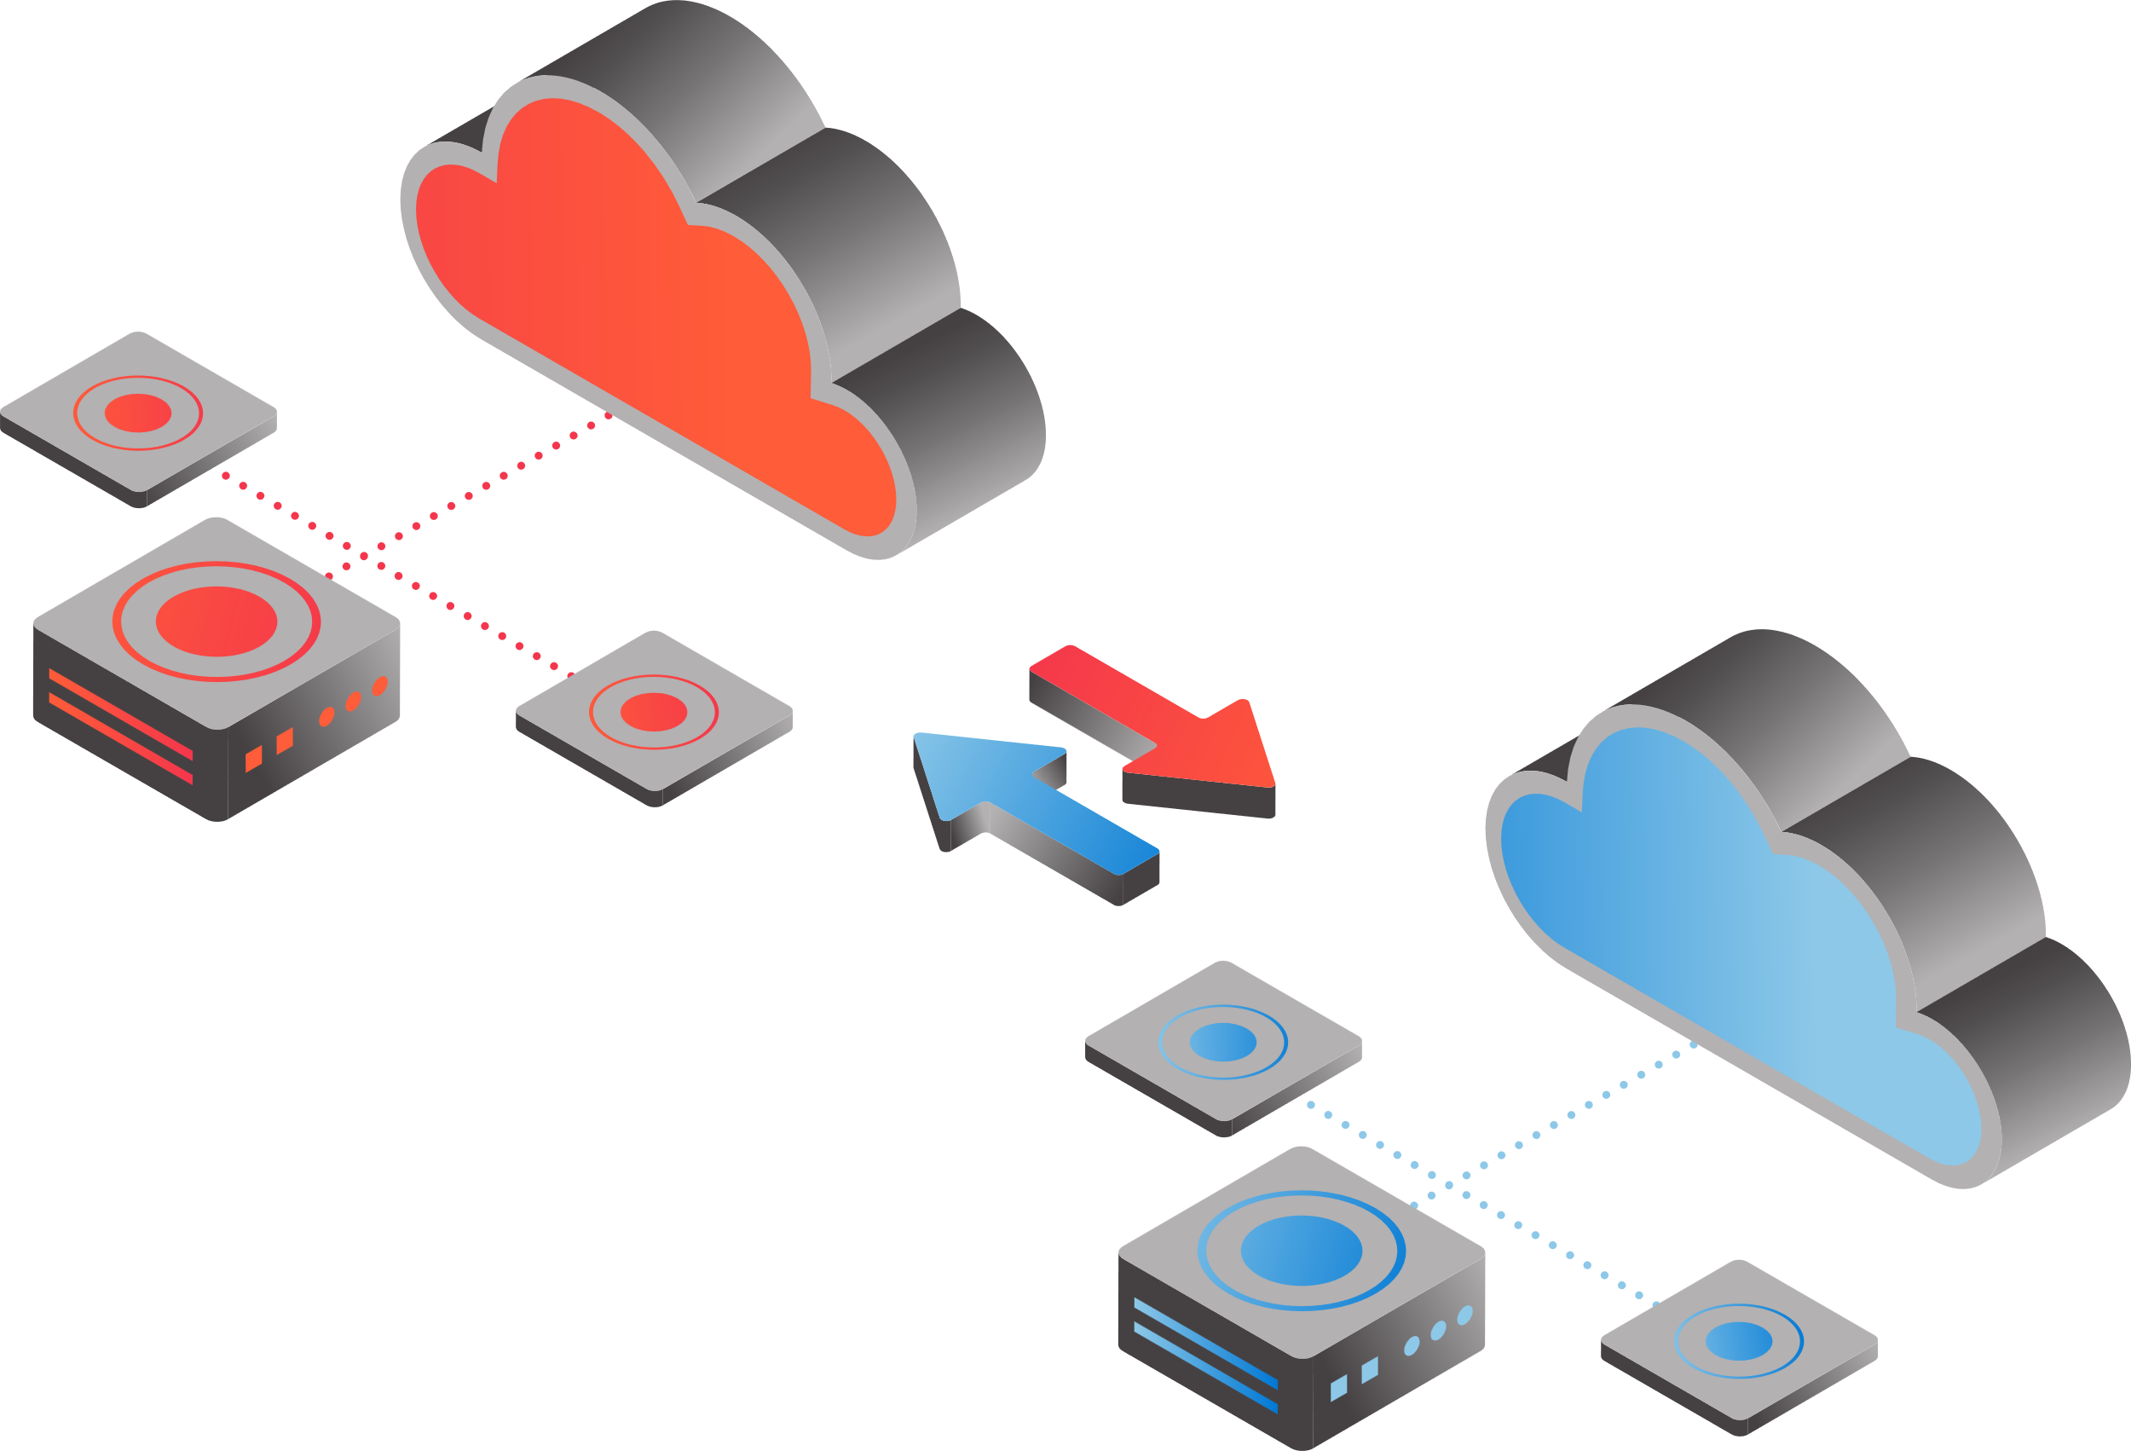
Azure Data Transfer CDS as a Service
Enterprise Cross Domain Service that enables customers to securely transfer data using Azure into Air-Gapped Clouds
Designed to meet NCDSMO Raise the Bar security requirements
Built as a multi-region solution for mission resilience
Operated 24x7 365 days per year
Available now for US Government and National Industrial Security Program (NISP) customers

Slide 2



Azure Data Transfer - How it works (Blobs | Messaging)
COLLECT
SCAN/FILTER
DELIVER
ADT Collects data from a Blob Container or a Service Bus Queue
ADT Scans and Filters data using NCDSMO Raise the Bar (RTB) compliant systems and architecture patterns
ADT Delivers data to the configured destination
Tenant
Tenant
Blob Storage Container
ADT
Blob Storage Container
Service Bus Queue
Service Bus Queue
Notes:
File Transfer
File transfer through Azure Blob Storage
Drag and drop using Azure Portal and Azure Storage Explorer
Machine-to-machine transfers using Azure Blob Storage APIs
Drop off methods
Azure Portal
Storage Tools
Storage APIs
Service Bus APIs
Messaging Services
Structured messaging services through Azure Service Bus
Low latency delivery options
Data transformation to/from supported data types enabled through Azure Logic Apps or third-party tools
Pickup methods
Azure Portal
Storage Tools
Storage APIs
Service Bus APIs

Slide 3

Azure Data Transfer - How it works (Messaging)
RECEIVE
Validate SCHEMA
PUBLISH
ADT Receives XML messages published into a Customer’s Azure Service Bus Queue.
ADT validates the XML against the schemas associated with the dataflow using NCDSMO Raise the Bar (RTB) compliant systems and architecture patterns
ADT publishes the XML message into the Customer’s destination Service Bus Queue
Service Bus
Service Bus
Tenant
Tenant
ADT
Notes:
File Transfer
File transfer through Azure Blob Storage
Drag and drop using Azure Portal and Azure Storage Explorer
Machine-to-machine transfers using Azure Blob Storage APIs
Messaging Services
Structured messaging services through Azure Service Bus
Low latency delivery options
Data transformation to/from supported data types enabled through Azure Logic Apps or third-party tools

Slide 4
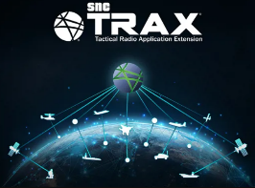



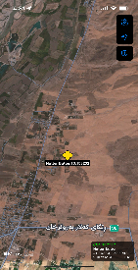

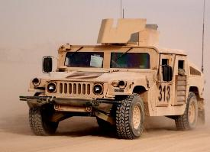
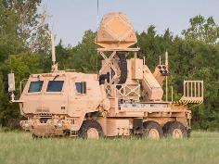
Messaging Use Case: TAK / TRAX / OMNI
Azure
Government (DoD IL2-5)
Azure Secret (DoD IL6)
ADT
Bi-Directional
Additional IL6
Data Sources
Sensors / Feeds
Operations Center
TAK-enable War Fighter

Slide 5

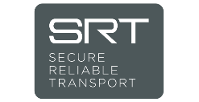
Azure Data Transfer - How it works (Streaming | FMV)
ACCEPT
TRANSCODE / FILTER
DELIVER
ADT Accepts an MPEG-TS Stream encrypted with Secure Reliable Transport (SRT)
ADT transcodes the MPEG-TS Stream and Filters the KLV data using NCDSMO Raise the Bar (RTB) compliant systems and architecture patterns
ADT Delivers the transcoded stream to the configured destination encrypted with SRT
Tenant
Tenant
ADT
Notes:
File Transfer
File transfer through Azure Blob Storage
Drag and drop using Azure Portal and Azure Storage Explorer
Machine-to-machine transfers using Azure Blob Storage APIs
Messaging Services
Structured messaging services through Azure Service Bus
Low latency delivery options
Data transformation to/from supported data types enabled through Azure Logic Apps or third-party tools

Slide 6






FMV – Deployment Scenario
Service
Bus
Storage
Event
Hubs
Service
Bus
Storage
Event
Hubs
SOURCE CLUSTER
CDS
Solution
Customer
IL6 Network
IL2 Edge Network
Load Balancer
UDP port 1
DESTINATION CLUSTER
MPEG-TS/UDP, SRT
MPEG-TS/UDP, RTP, SRT
Load Balancer
VM
UDP port 2
VM
UDP port 1
VM
VM
VM
VM
Feed 1
UDP port 3
Feed 2
Feed 3
ADT Helps Enable a Common Operating Picture in IL6, with FMV across IL2, IL5, & IL6:
Joint operations with partner countries
Group 1-3 / Self-deploy UAS platforms operating at IL2 and MQ1, MQ9 platforms operating at IL6
Training missions operating across IL2, IL5, & IL6

